Slide 1

Skip List
Harjot Sohi
Sunny Pak

Slide 2

Purpose
Our main focus of the algorithm, Skip List, is to:
Analyze
Understand
Implement
Examine

Slide 3
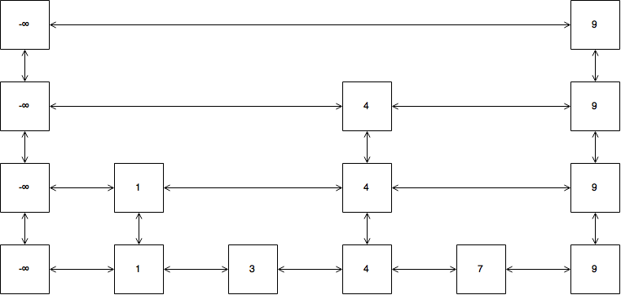
What is Skip List?
A data structure to store sorted elements
Adds extra links to "skip" over nodes for faster searching
Node height is chosen randomly
Handles dynamic data that changes often
Fast operations: search, insert, delete in O(log n) time
Easier to build than balanced trees like AVL or red-black trees
Useful for quick and simple performance

Slide 4
Algorithm of Skip List
Search Algorithm:
Starts at the topmost level.
Moves right until the target node is greater than the current node, then moves down a level.
Repeats until the target node is found or the lowest level is reached.
Insertion Algorithm:
Find the correct position on each level.
Insert the new node at the lowest level.
Promote the node to higher levels based on random decisions.
Deletion Algorithm:
Locate the node across all levels.
Remove it from each level where it appears.
Time Complexity: Average O(log n) for search, insert, and delete operations.

Slide 5


Advantages and Disadvantages
Advantages of Skip List:
Reliable with fast insertion of new nodes
Easier to implement than hash tables or binary search trees
Adding more nodes reduces the chance of worst-case performance
Average time complexity: O(log n) for most operations
Easy to search for a node
Disadvantages of Skip List:
Requires more memory than balanced trees.
Does not support reverse searching.
Can be slower than linked lists for certain operations.
Not optimized for caching, which may affect performance.

Slide 6

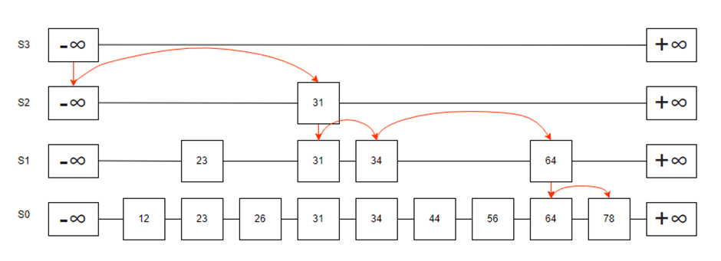
Search
Search starts at the top and moves down through levels
Checks the next node’s value to decide whether to move right or down
If the next node is too large or missing, it moves to the lower level
Repeats until the key is found or the lowest level is reached
Skips over nodes for faster searching
Average search time: O(log n), quicker than a regular linked list

Slide 7
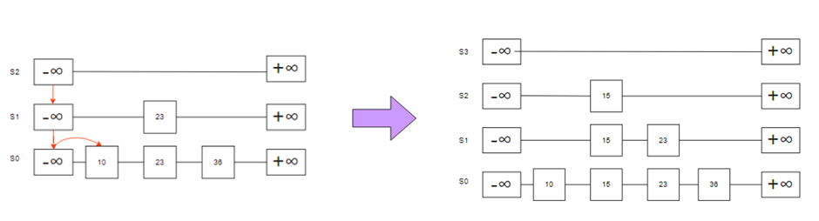




Insertion
The randomness in a skip list is achieved through the probability of a coin toss, 1:1, where head represents "promotion" to the next level. Tail represents no promotion, meaning it staying at current level.
If the coin lands heads consecutively, say twice, it results in a value of i=2. If value exceeds the current skip lists’ height h, it will add i+1 of the height on top of the list.
Case where value of the insert key is 15...and i=2
Begin at S2, and if 15 is not present, It will insert 15
Move down a layer
Sequential search will occur
If value is larger than 15, stop and insert 15
Connect 15s across all the layers
Repeat until you reach bottom list and have gone through all the nodes

Slide 8
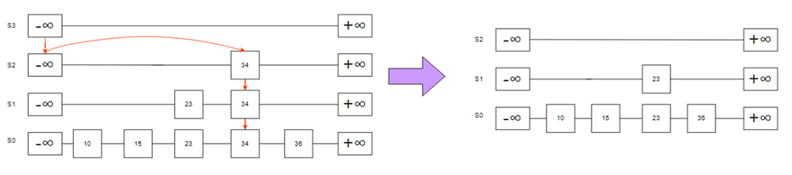





Deletion
Identifies all connected keys, by traversing
Deleting one key deletes all the corresponding key, and layer if necessary.

Slide 9
Findings
It is improved from linked list
multiple pointers in skip list travel across different layers, where each layer can skip elements for efficient search process
It is probabilistic and stochastic data structure
50-50 random chance to be promoted to next level
It encompasses the elements found in the upper layers
Level 0 contains all elements arranged in order
Each level contains subset of elements acting as shortcuts

Slide 10
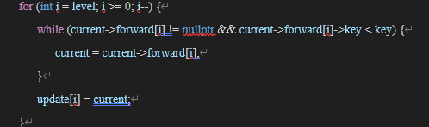
Implementations (C++)
Algorithm starts at highest level and moves horizontally using forward pointers.
If the current key is less than the target key, it moves to the next node at the same level. If the current key is greater than or equal to the target key, it drops down a level to continue searching.

Slide 11
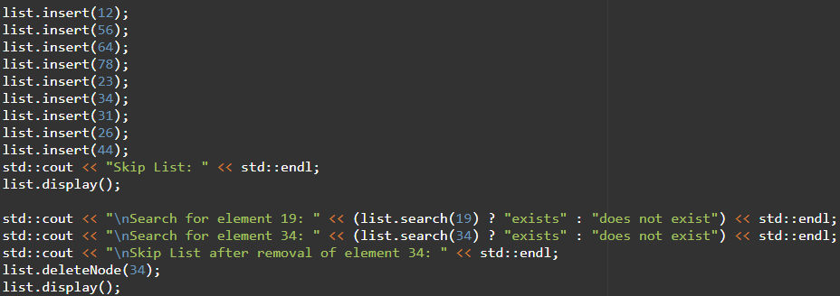
Implementations (C++)
Inserted all different elements in random order and to print after insertion and deletion

Slide 12
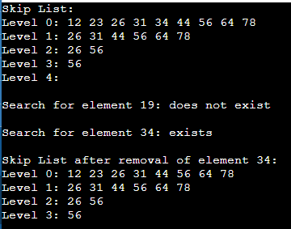
Output (C++)
List is organized in ascending order
26 and 56 were promoted randomly
Level 4 layer got removed after deletion because skip list dynamically adjusts itself

Slide 13

Algorithm Approach (Java)
Initialization:
Create a skip list with a specified maximum number of levels.
Each level is represented by a linked list.
Node Structure:
Each node has pointers to the next node at the same level and the node below it.
Insertion:
Start from the top level and move down to find the correct position for the new key.
Keep track of nodes to update using an array.
Randomly determine the height of the new node using a coin-flipping method.
Searching:
Begin at the top level and navigate downwards to find the target key.
Efficiently skip over nodes to speed up the search process.
Deletion:
Locate the node to be removed across all levels.
Update pointers to remove the node from the list.
Efficiency:
The average time complexity for search and insertion is O(log n).
The algorithm combines simplicity and efficiency for managing dynamic datasets

Slide 14
Implementations (Java)
Displaying the Skip List:
display method:
Shows the structure of the skip list.
Prints the values from the top level down to the bottom level.
Main Function:
Tests features:
Creates a skip list with 16 levels.
Adds keys and displays the list.
Tests searching for existing and non-existing keys.
Tests removing a key and shows the updated list.
Node Structure:
Node Class: Represents an element in the skip list.
Properties:
value: Stores the data.
next: Points to the next node on the same level.
down: Points to the node on the lower level.
Constructor: Initializes these properties when a new node is created.
Constructor:
Initializes:
The topHead node with the maximum possible value.
Creates additional head nodes for each level and links them using down pointers.
Node Creation (createNode Method):
Purpose: Creates a new node easily.
Inputs:
value: Value to store in the node.
next: Pointer to the next node on the same level.
down: Pointer to the node at the lower level.
Output: A new node with the provided values and pointers.
SkipList Class:
Purpose: Manages the operations of the skip list (adding, finding, and removing nodes).
Key Properties:
topHead: Points to the head of the topmost level.
maxLevels: Defines the maximum number of levels.
Random object: Determines how high a node is promoted in the levels.

Slide 15
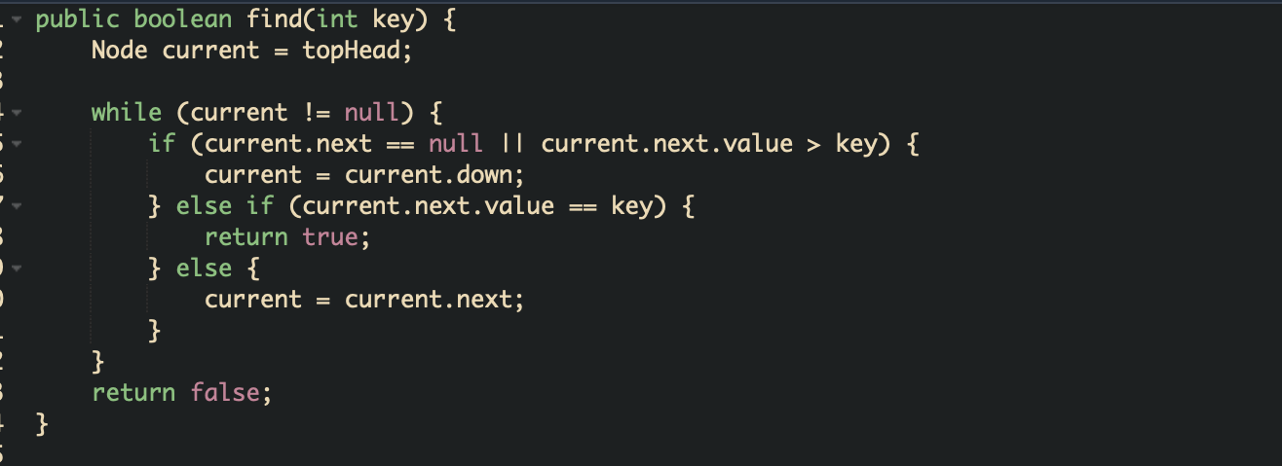
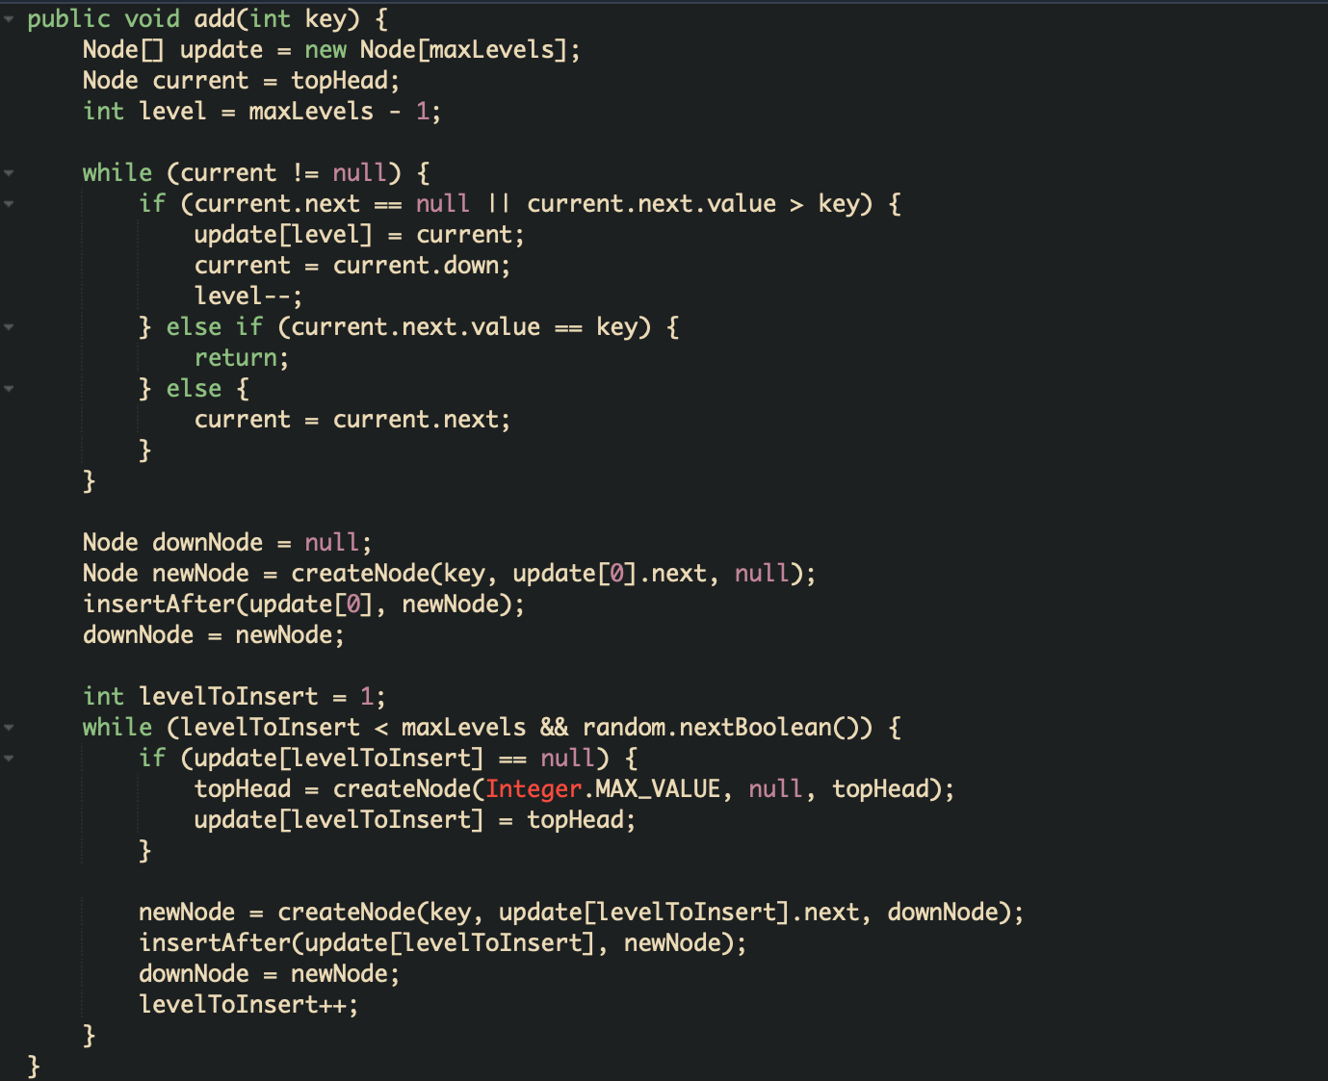
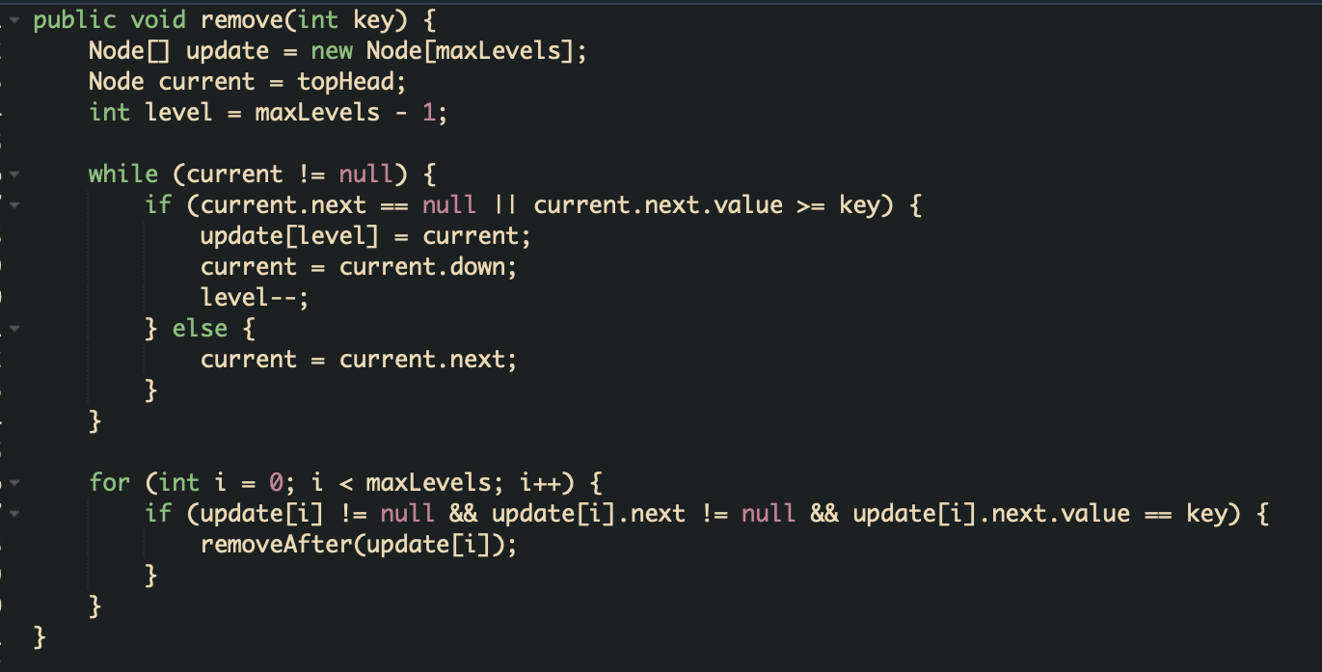
Implementations (Java) cont.
Searching:
find method: Looks for a specific key in the skip list.
Insertion:
add method: Inserts a new key and promotes it randomly.
Deletion:
remove method: Removes a specified key from the skip list.

Slide 16
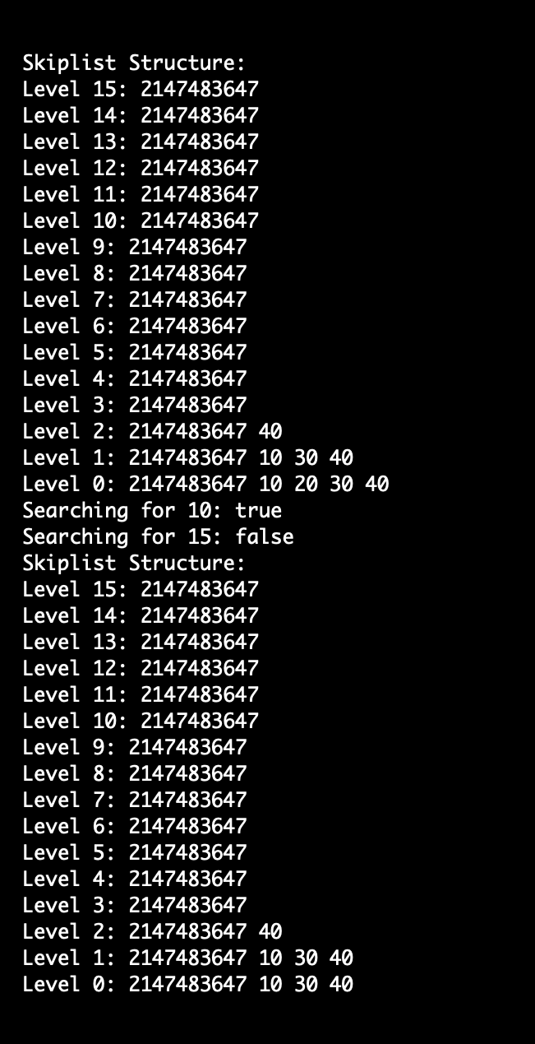
Output (Java)
The skip list has 16 levels.
Levels 15 to 5 only have the sentinel value 2147483647.
Level 2 has the element 40 added.
Level 1 has 10, 30, and 40.
Level 0 has 10, 20, 30, and 40.
Searching for 10 is successful, but searching for 15 fails.
After searching, 20 is removed from Level 0, leaving 10, 30, and 40

Slide 17

Some interesting stuff…to share
Address space layout randomization
Randomized structure is resistant in cyberattacks, because address cannot be specified easily.

Slide 18
Project Management
We used tools such as:
GitHub: Track process, share codes and references
Discord/Outlook: Communiation tools for problems/suggestions
Powerpoint collaboration to check progress real time
Reports and Implementations of both languages, C++, Java
Visual studio code to implement and run test cases & debug in C++
Jdoodle online java compiler to implement and run test cases & debug in Java
https://github.com/sunnybutrainy/comp359-assignment2

